Slide 1



Slide 2

Local Ecosystem
Loyalty of Driver
Ride Monitoring System
KYC
Feedback loop
Brand Ambassador
Cash drain
Dependency
Control
Trust building
Base price
Surge Multiplier
Booking fee
Cost per km * Time
Cost per min * Time
Per Capital Income
1,84,000 per year
500 per day
15,000 per month

Slide 3

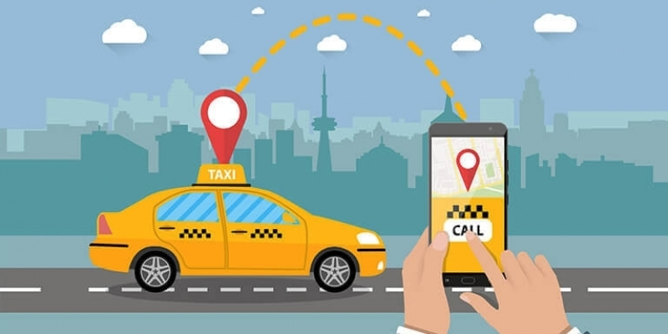
Domain: Transportation & Mobility
Function: Operations
Trip volume
Passenger satisfaction
Repeat passenger rate
Trip distribution
Balance between new and repeat passengers
This Photo by Unknown Author is licensed under CC BY-SA-NC

Slide 4
A cab service company established two years ago, has gained a strong foothold in the Indian market by focusing on tier-2 cities.
Good cabs is committed to supporting local drivers, helping them make a sustainable living in their hometowns while ensuring excellent service to passengers.

Slide 5
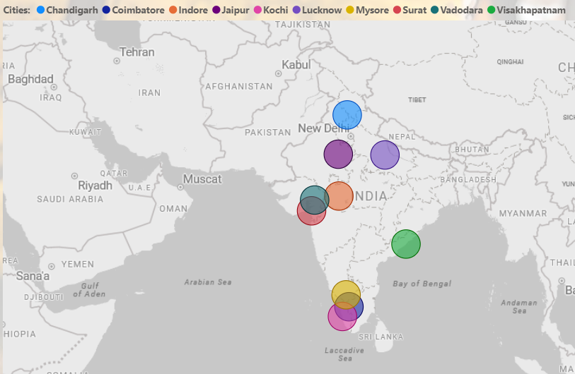
With operations in ten tier-2 cities across India, Good cabs has set ambitious performance targets for 2024 to drive growth and improve passenger satisfaction.
As part of this initiative, the Good cabs management team aims to assess the company’s performance across various key metrics.

Slide 6

Thakur Prem Singh
I have 3 YOE in IT industry and Working At TCS (Dec-2024)
thakurpremsingh153@gmail.com
https://www.linkedin.com/in/thakur-prem-singh-61943715a

Slide 7
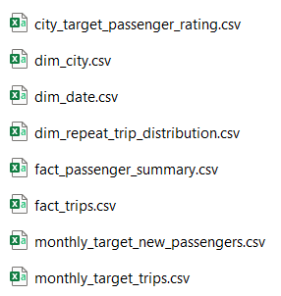
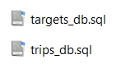




Data Sets
Csv files
Database

Slide 8
AD-HOC REQUESTS
City-Level Fare and Trip Summary Report
Monthly City-Level Trips Target Performance Report
City-Level Repeat Passenger Trip Frequency Report
Identify Cities with Highest and Lowest Total New Passengers
Identify Month with Highest Revenue for Each City
Repeat Passenger Rate Analysis

Slide 9
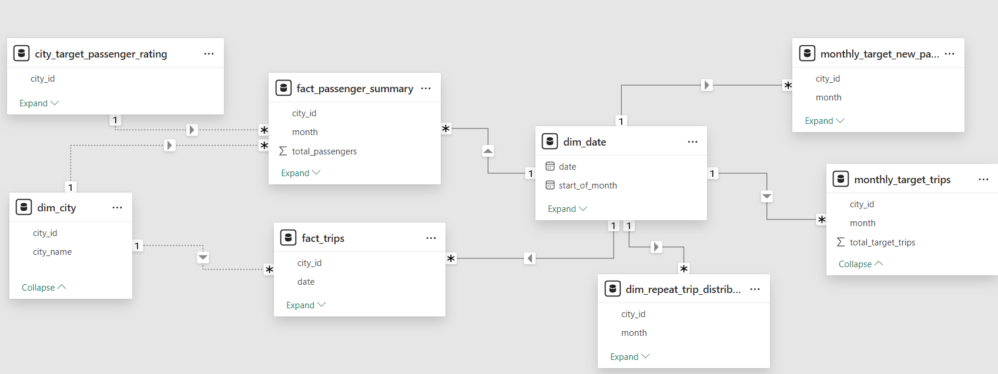
Data Model (connecting tables)

Slide 10
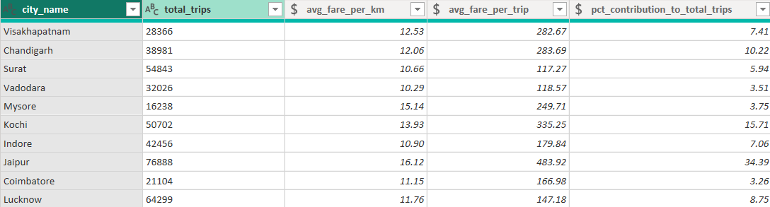
City-Level Fare and Trip Summary Report

Slide 11

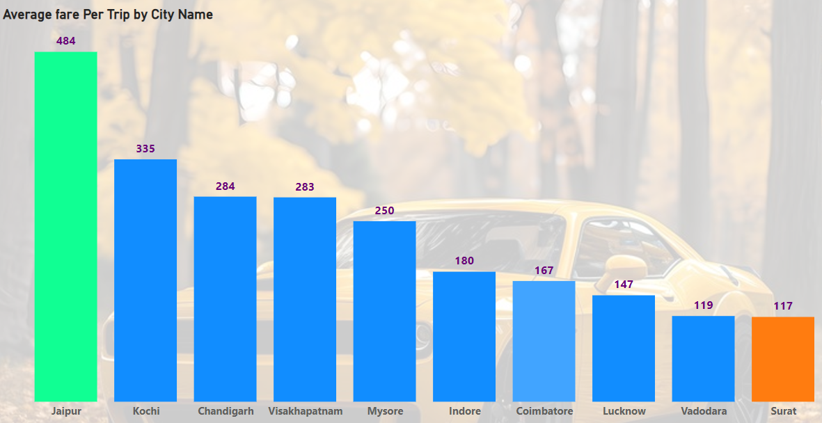
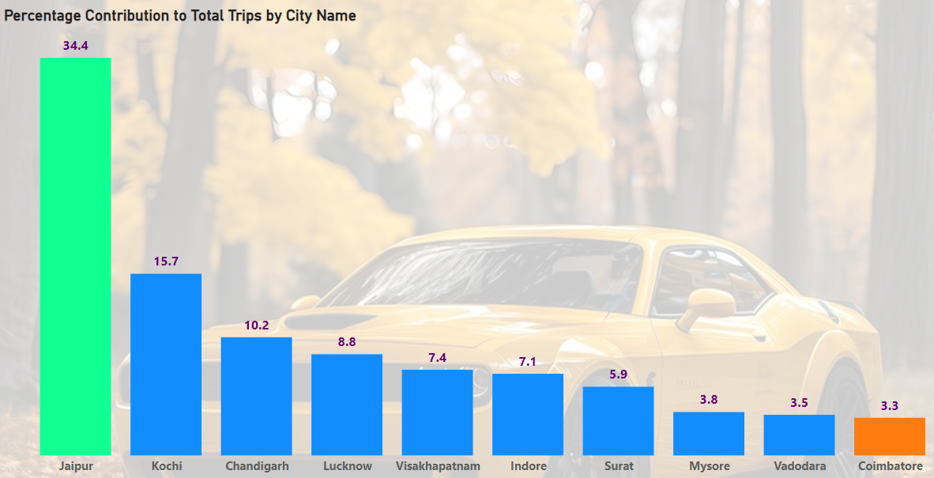
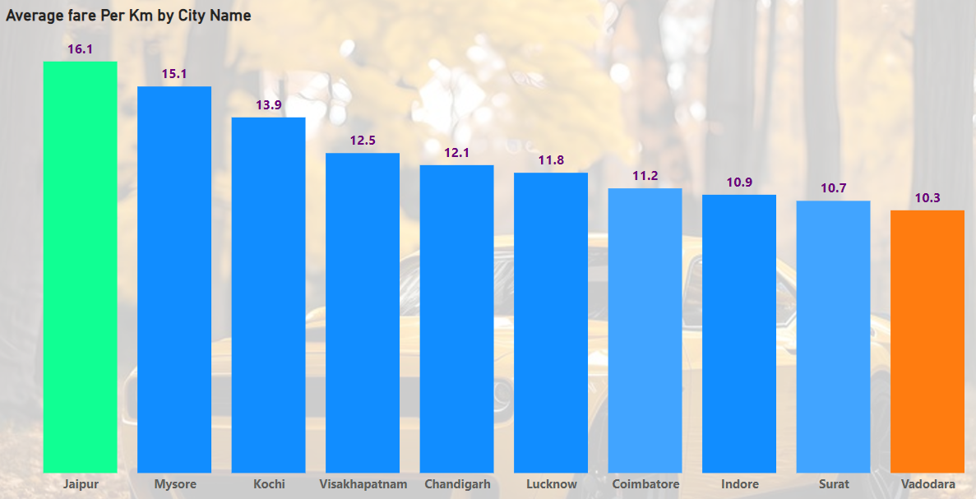
City-Level Fare and Trip Summary Report
Jaipur is leading in above key metrics (Average fare per trip, Percentage contribution to total trips & Average fare per km)
Surat has least Average fare per trip
Coimbatore has least percentage contribution to total trips
Vadodara has least Average fare per km
Insights:

Slide 12
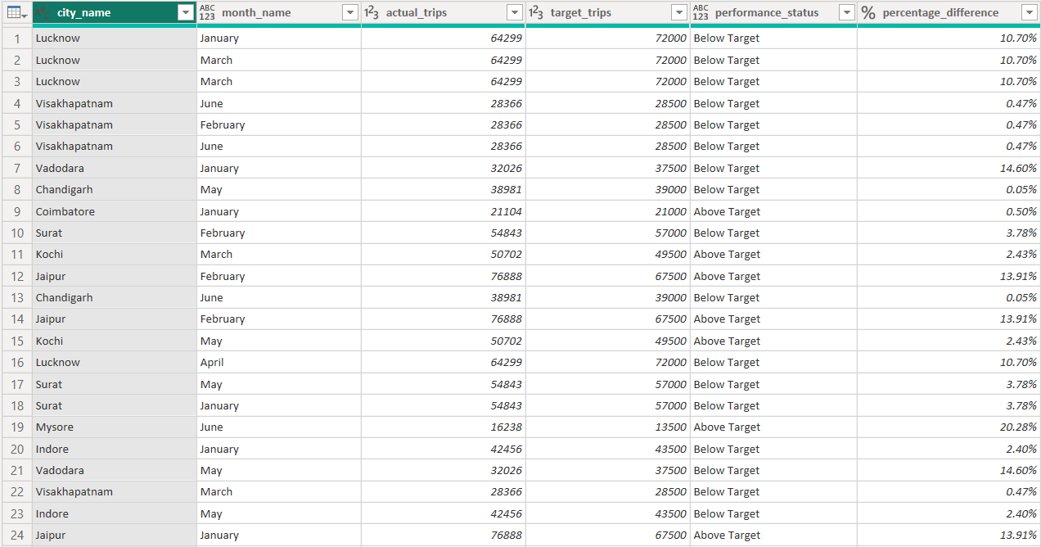
Monthly City-Level Trips Target Performance Report

Slide 13
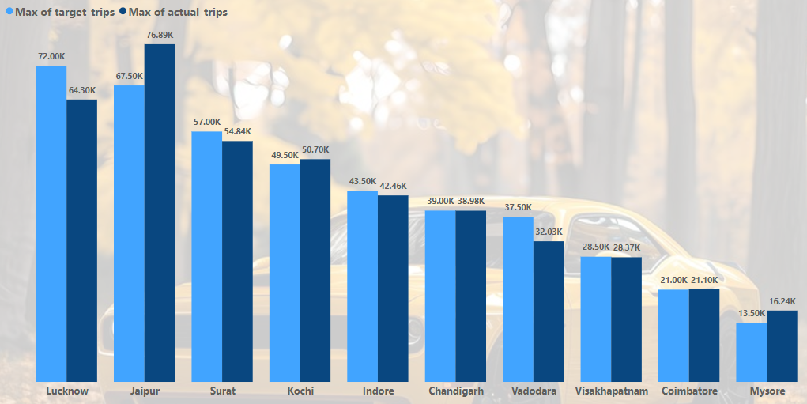
Monthly City-Level Trips Target Performance Report
Insights:
Jaipur performance is best with 14.64% more than as targeted
Lucknow performance is least with 10.69% less than as targeted
Out of 10 cities 40 % cities reached above target value and 60% cities fall below target value

Slide 14
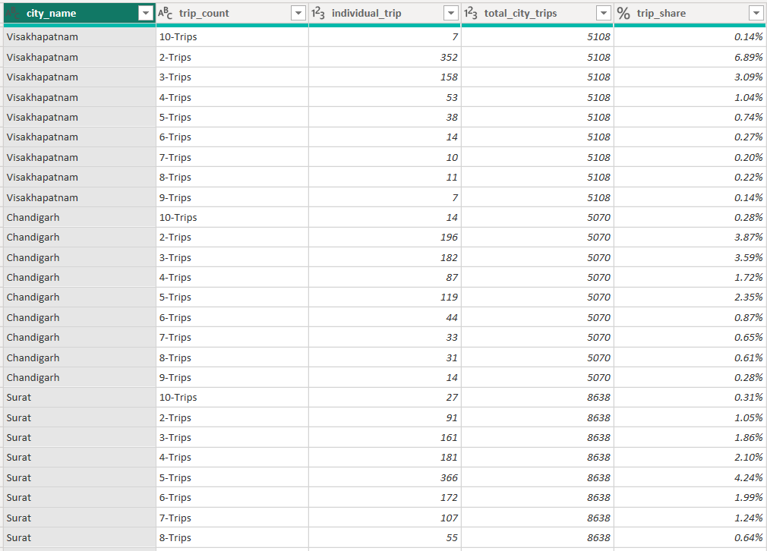
City-Level Repeat Passenger Trip Frequency Report

Slide 15
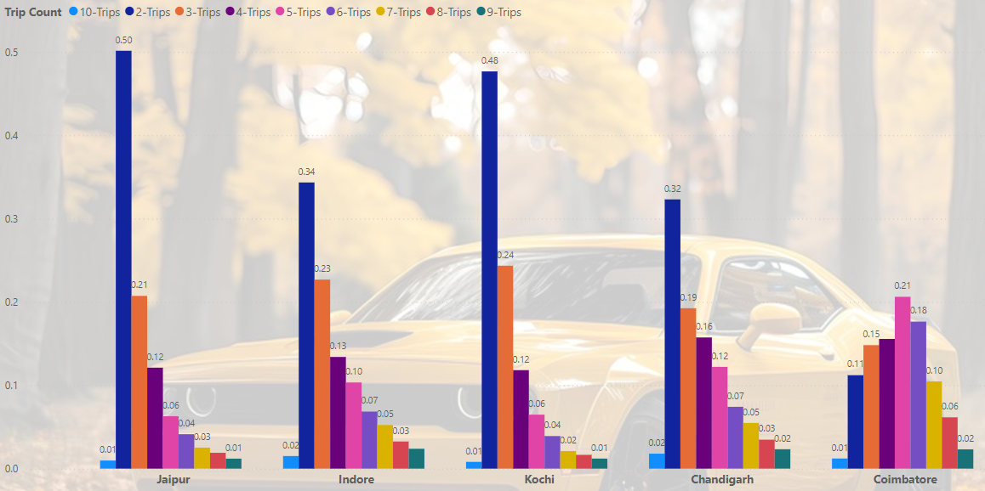
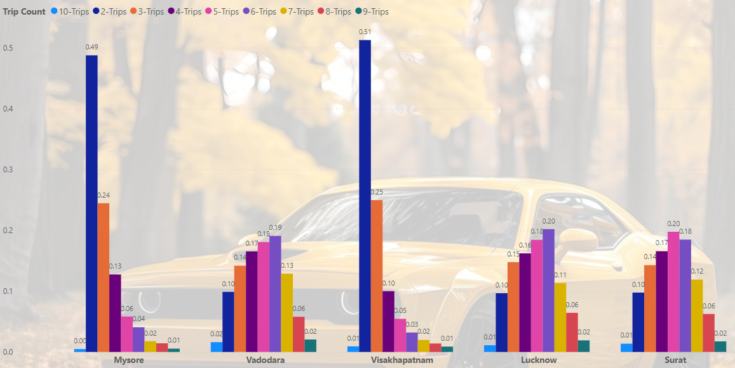
City-Level Repeat Passenger Trip Frequency Report
Insights:
Out of 10 cities 60% cities has peaked in 2 trips
Surat & Coimbatore peaked in 5 trips count, Vadodara & Lucknow peaked in 6 trips count

Slide 16
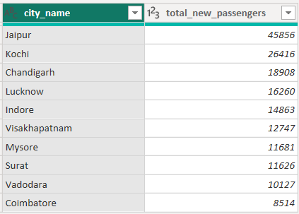
Identify Cities with Highest and Lowest Total New Passengers

Slide 17
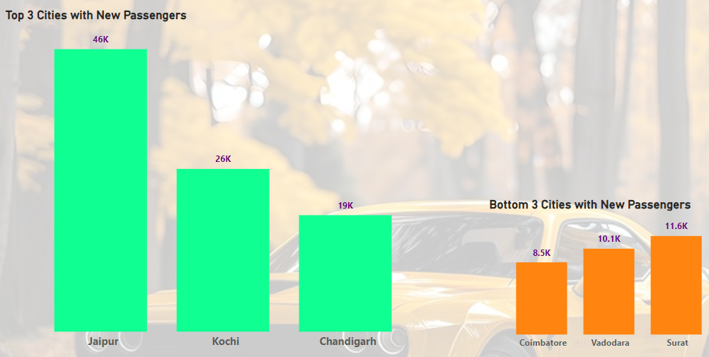
Identify Cities with Highest and Lowest Total New Passengers
Out of 10 cities Jaipur has highest total new passengers and Coimbatore has the least total new passengers
Coimbatore has only 18.56% of new passengers as that of Jaipur
Jaipur has 25.90% of new passengers as that of total new passengers
Insights:

Slide 18
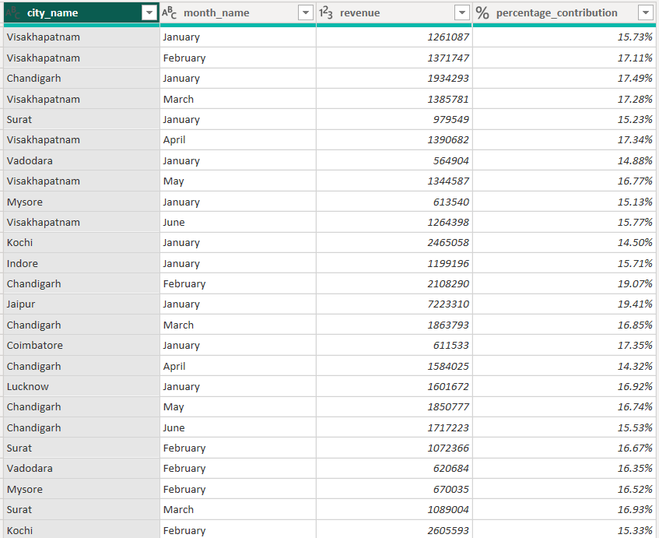
Identify Month with Highest Revenue for Each City

Slide 19
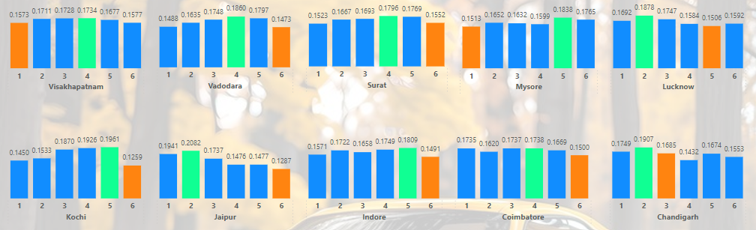
Identify Month with Highest Revenue for Each City
Insights:
Out of 10 cities, 40% of cities has April as Highest revenue month & 30% of cities has May as Highest revenue month
Out of 10 cities, 60% of cities has June as Lowest revenue month

Slide 20
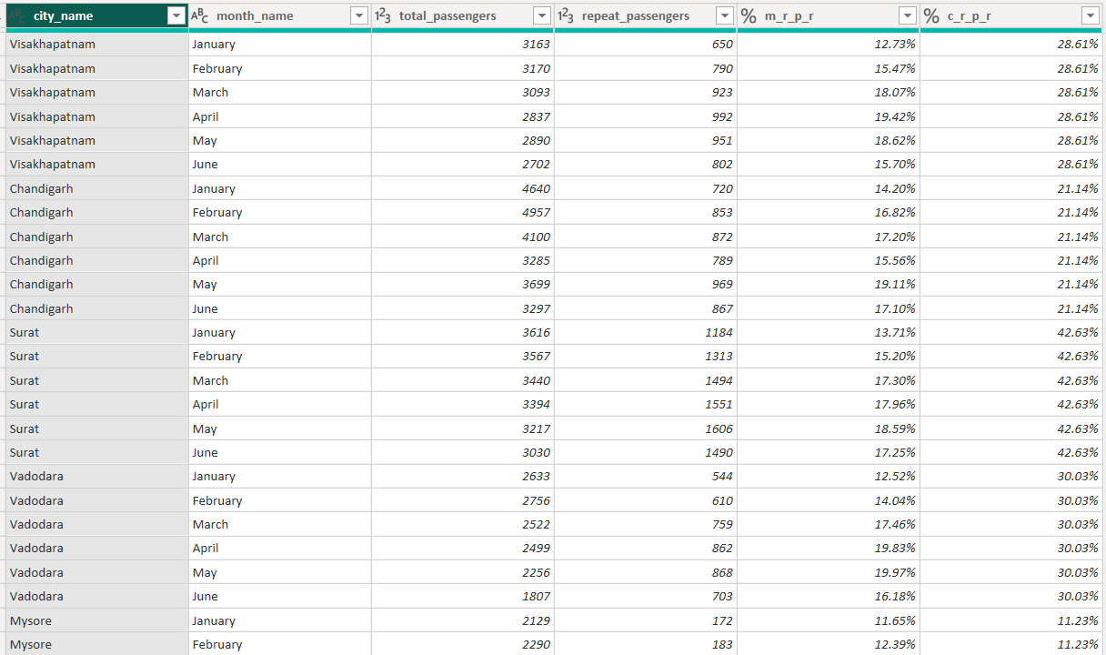
Repeat Passenger Rate Analysis

Slide 21
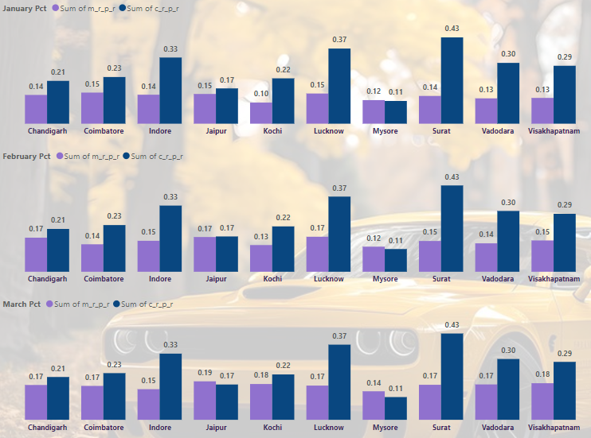
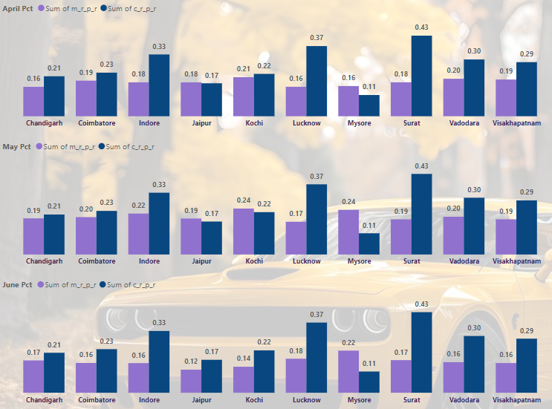
Repeat Passenger Rate Analysis
Insights:
Monthly repeat passenger rate % is highest for Kochi city in May month with 24.29% and least is also for Kochi city with 10.42% in January month
City repeat passenger rate % is highest for Surat city with 42.62% and least is for Mysore with 11.22%

Slide 22
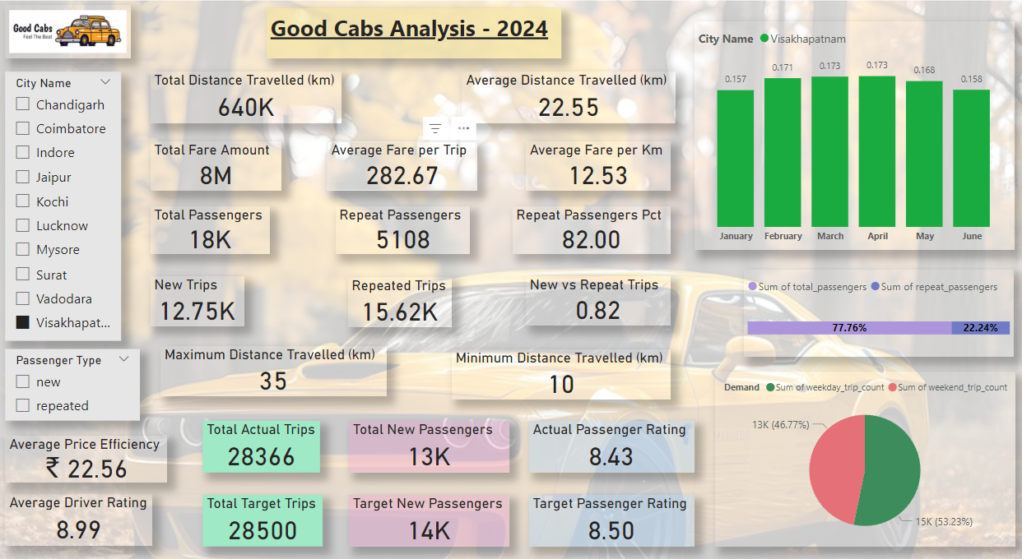
Sample Dashboard (Visakhapatnam)

Slide 23
CONCLUSION:
Top 3 performing cities based on total trips are Jaipur (one-third), Kochi & Chandigarh
Bottom 3 performing cities based on total trips are Coimbatore, Vadodara, Mysore
Top 3 performing cities based on price efficiency are Jaipur (30%), Kochi & Chandigarh
Bottom 3 performing cities based on price efficiency are Surat, Vadodara & Lucknow
Highest average passenger rating (new passengers) is Kochi with 8.98
Highest average passenger rating (repeat passengers) is Kochi with 8.00
Lowest average passenger rating (new passengers) is Lucknow with 7.97
Lowest average passenger rating (repeat passengers) is Vadodara with 5.97
Peak demand month (example Visakhapatnam) is April
Low demand month (example Visakhapatnam) is January
Weekday trip strong preference city is Lucknow with 70.41% more trips than on weekend
Weekend trip strong preference city is Mysore with34.54% more trips than on weekday
Vadodara & Lucknow peaked with 6 trips count and are business-focused cities
Chandigarh & Visakhapatnam lacks in terms of monthly evaluation against total trips, new passengers & average passenger ratings.
Top 2 cities with monthly repeat rate passengers' percentage are Kochi (May) & Mysore (May)
Bottom 2 cities with monthly repeat rate passengers' percentage are Kochi (January) & Mysore (January)
Top 2 cities with city repeat rate passengers' percentage are Surat & Lucknow
Bottom 2 cities with city repeat rate passengers' percentage are Mysore & Jaipur

Slide 24
RECOMMENDATIONS:
Live Ride Monitoring: Allow friends or family to track rides through shared links.
Train Drivers: Provide training on customer service, safe driving practices, and local navigation.
Dynamic Fleet Allocation: Use data analytics to predict demand and position cabs accordingly.
Driver Profiles: Allow customers to view driver details and ratings before booking.
Multiple Payment Options: Support various payment methods like cards, UPI, and digital wallets.
Reduce Wait Times: Increase fleet size or optimize scheduling to minimize waiting periods.
Regular Inspections: Conduct periodic checks to ensure cleanliness, comfort, and safety of vehicles.
Social Media Campaigns: Run targeted ads and promotions on platforms like Instagram, Facebook, and Twitter.
Transparent Surge Pricing: Notify users about price hikes due to demand and offer alternatives.
Health Benefits: Provide insurance or healthcare benefits for drivers.
Incentive Programs: Offer bonuses for high ratings and consistent performance.
Referral Programs: Offer discounts or free rides to customers who refer new users.
Partnerships: Collaborate with hotels, restaurants, airports, and events for exclusive cab services.
Local Advertising: Invest in billboards, radio, and local newspapers to increase visibility.

Slide 25
THANK YOU
thakurpremsingh153@gmail.com

